Slide 1
HOW CAN TECHNOLOGY AID IN THE PREDICTION OF AND RESPONSE TO NATURAL DISASTERS / HAZARDS? ​
BY NIAM​

Slide 2
Earthquakes

Slide 3
Quake scanners are used to detect miniature, subtle movements of the earth in preparation of a possible forthcoming earthquake

Slide 4
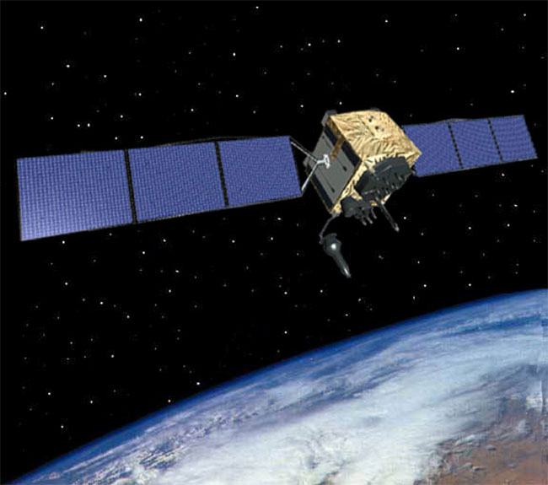
This is a newly created satellite from NASA that can detect the smallest of shakes of the earth from outer space!
Cover your head and neck with your arms. If a sturdy table or desk is nearby, crawl underneath it for shelter. If no shelter is nearby, crawl next to an interior wall.
Earthquake proof buildings can also be built

Slide 5
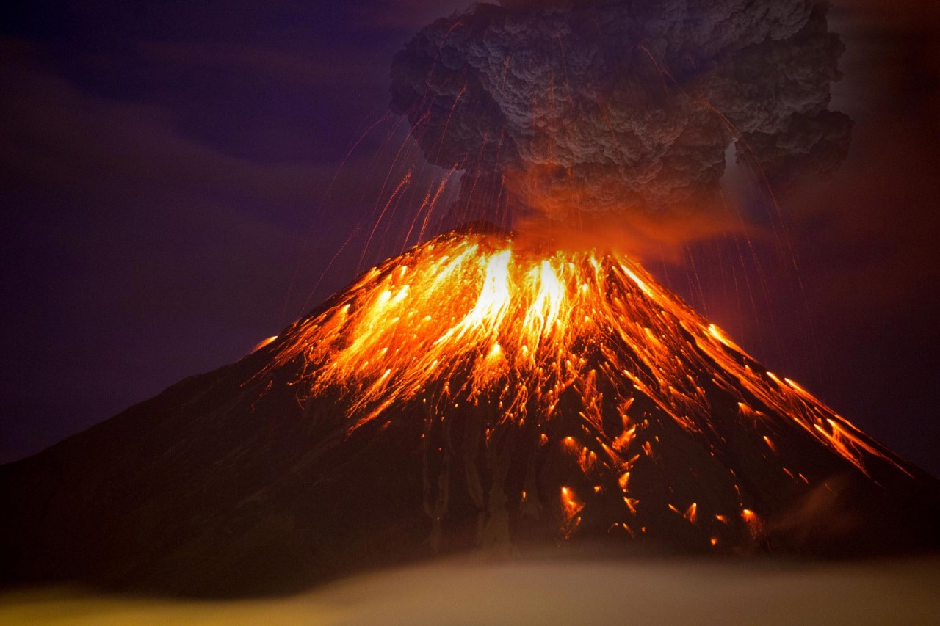
Volcanoes

Slide 6
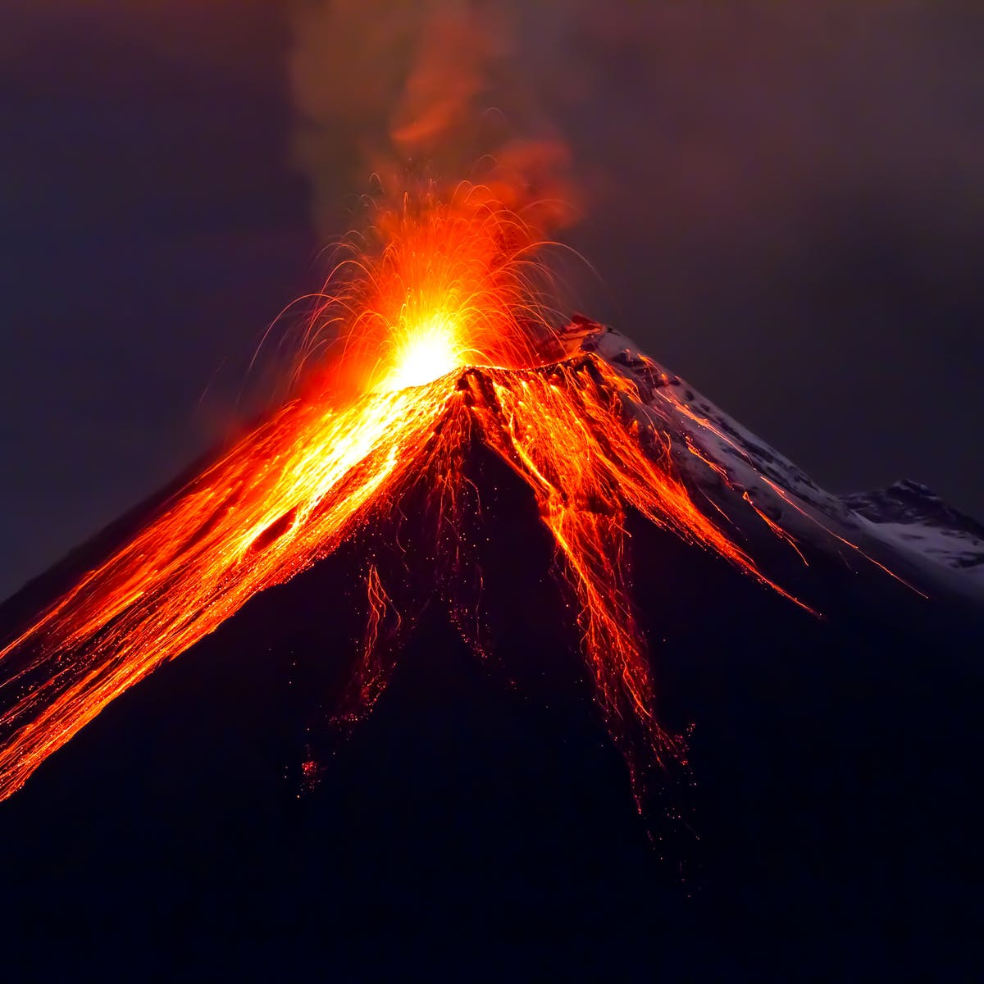
Charts can be used to predict the eruption of a volcano. This is by using frequencies of a variety of things.
This can even be accessed on a regular computer.

Slide 7
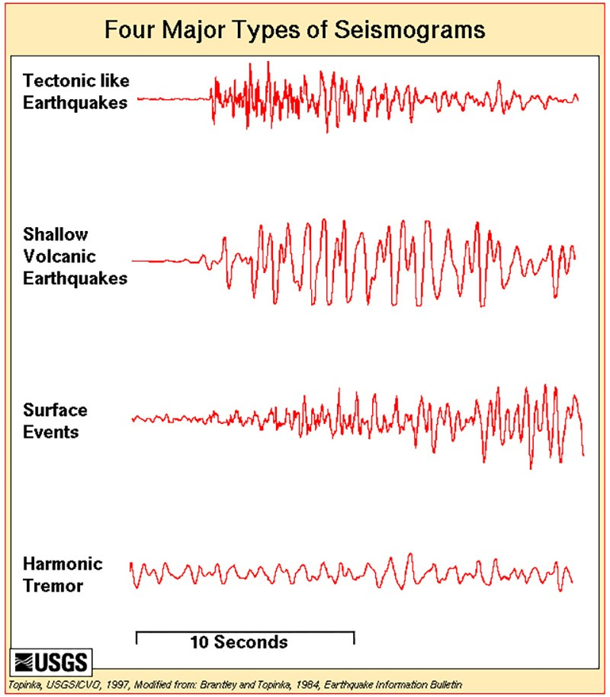
To respond to a volcanic eruption, avoid areas downstream of the eruption. Protect yourself from falling ash. Get under a form of shelter and evacuate if needed

Slide 8
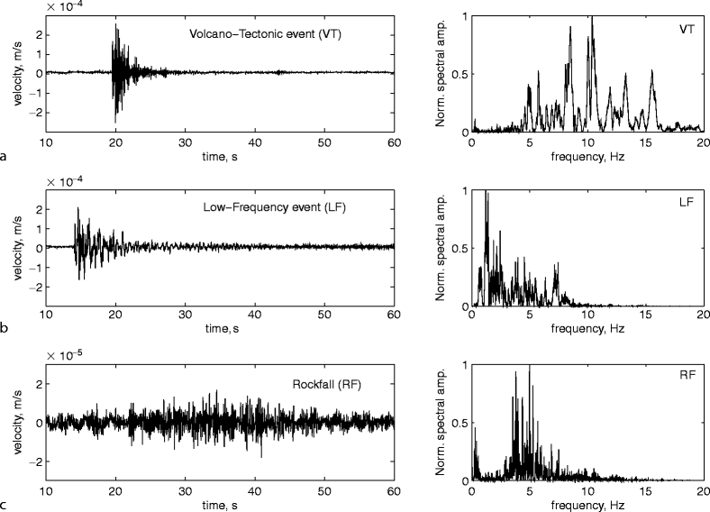

Slide 9
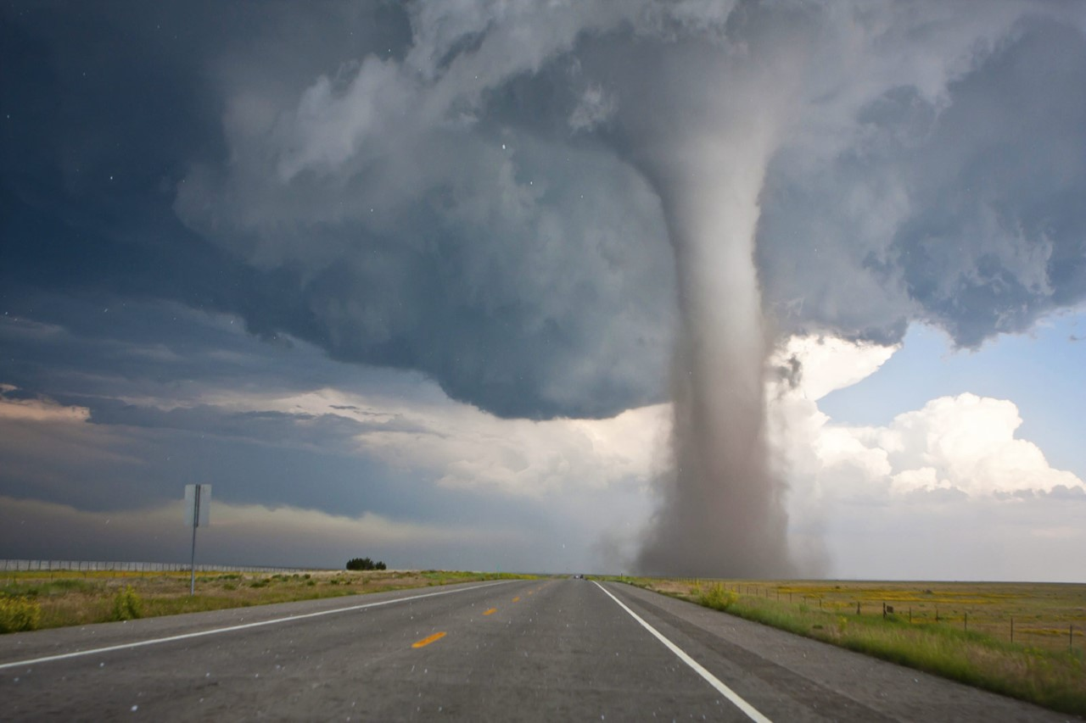
Tornadoes

Slide 10
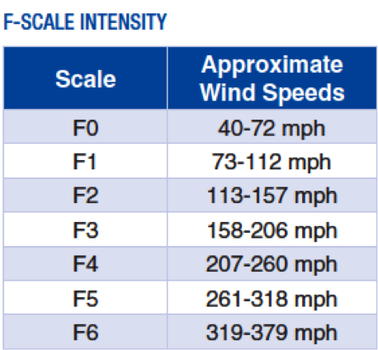
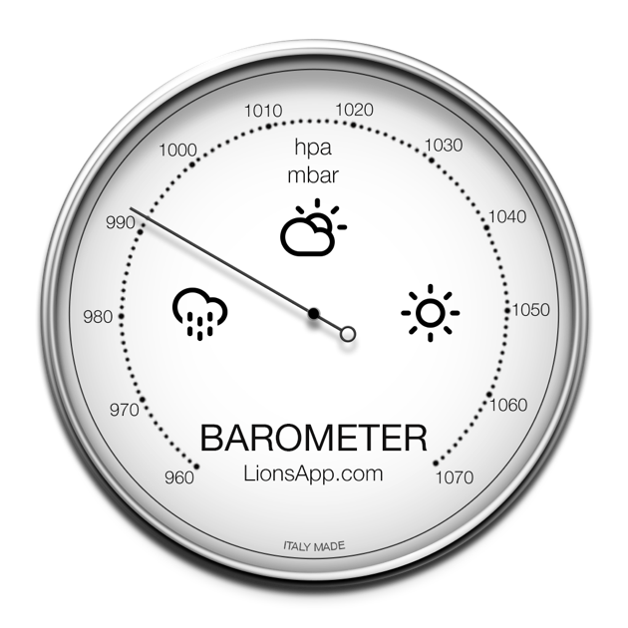
To predict when and where a tornado might whirl, scientists have a range of tools at their disposal. They can measure wind speed and pressure through weather stations
To respond to a tornado, you need to go to a sturdy building and go to a safe room like a basement or cellar or a room on the lowest floor

Slide 11
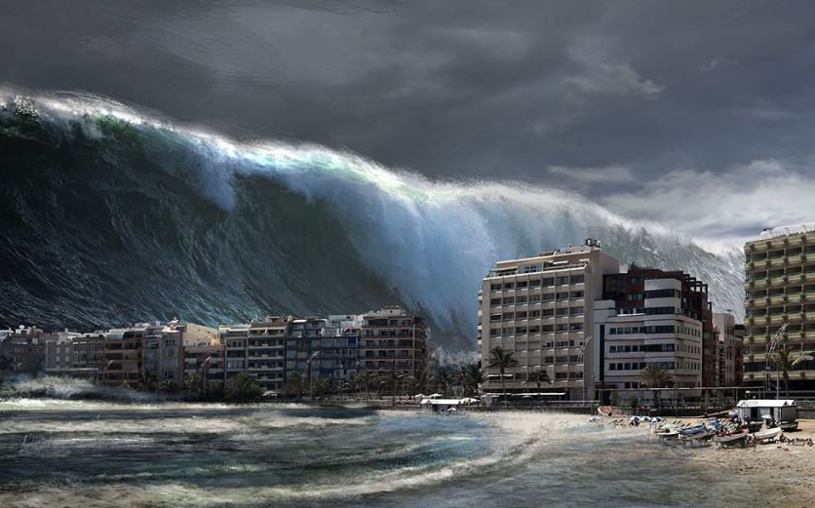
tsunami

Slide 12
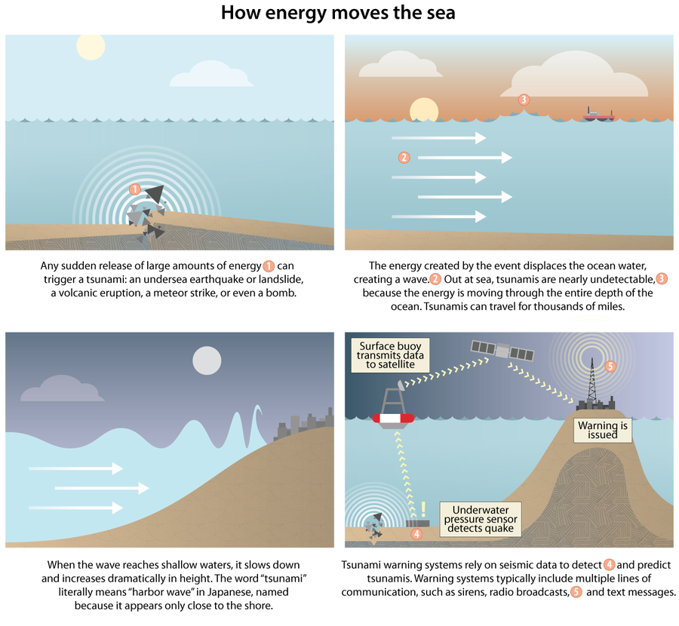
To help identify and predict the size of a tsunami, scientists look at the size and type of the underwater earthquake that precedes it. This is often the first information they receive, because seismic waves travel faster than tsunamis.

Slide 13
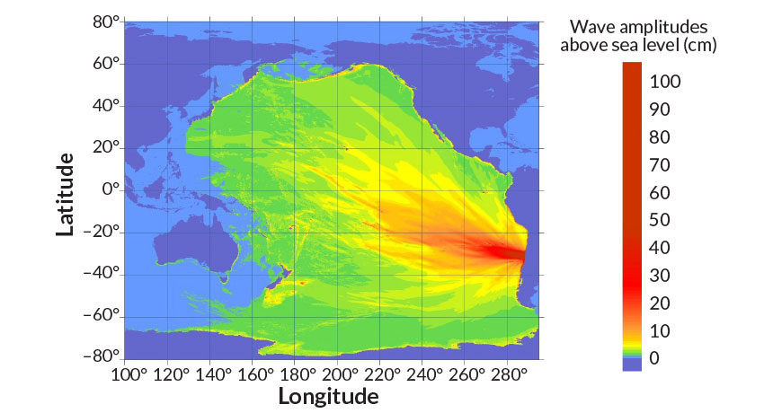
Get to high ground as far inland as possible.
If you are in a boat then quickly get to into sea.

