Slide 1
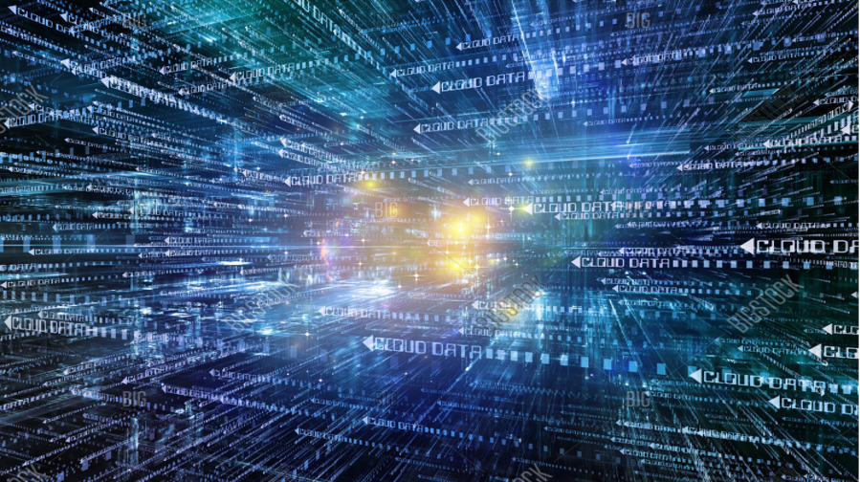
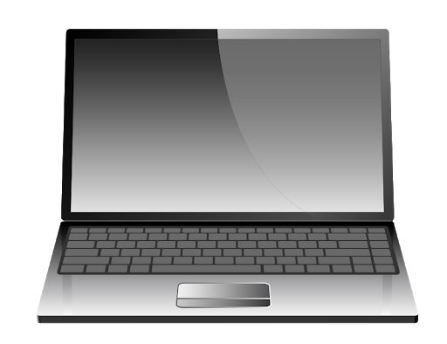
How has technology changed how we live our lives?
Technnology has changed our lives by increasing the speed of time. Technology has made the impossible possible. It is everywhere in our daily lives.
By Niam

Slide 2
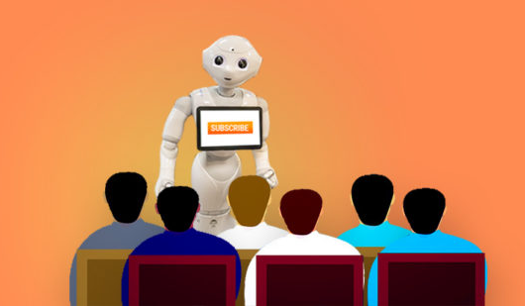
Technology(smart boards, laptops and phones) has changed education
Technology changed the ways of education and learning methods. We were not able in the past to get data, information, and knowledge so quickly with flexibility.
But today because of technology there are online schools. Anyone can do degrees online by using the internet and computers. There are various types of online courses for everyone.

Slide 3
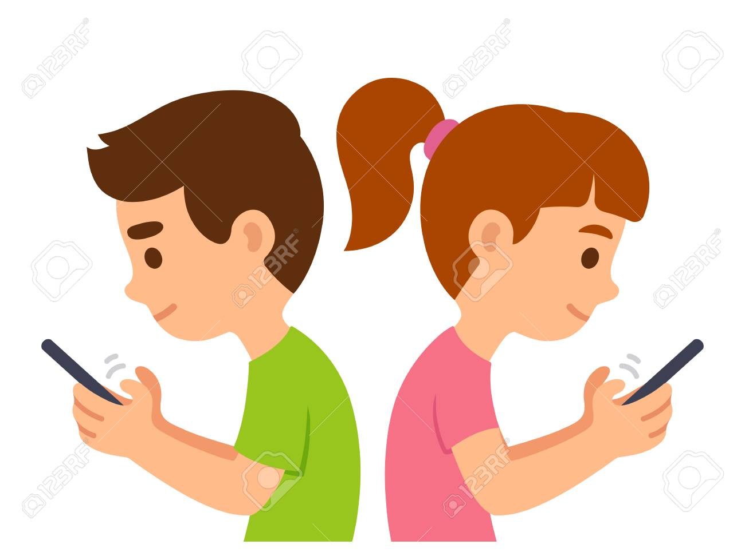
Technology changed the ways of communication
Today we have mobile phones, internet, computer and social media, and apps to communicate with anyone around the world. It was not possible in the past.
The benefit of communication is that it’s the fast, easy and a quick method to communicate.

Slide 4
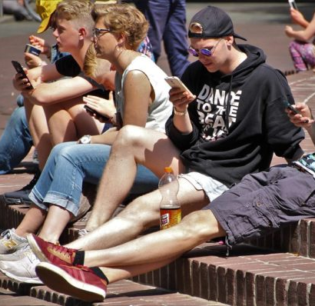
Technology causes distractions
Nowadays, most of the younger generation, teenagers, are mostly addicted to some form of technology being phones, consoles or even laptops
They are limiting their potential mind capacity. These distractions will not only gradually hinder their ability to broaden their minds throughout their life, but it will minimise their core skills for example: creativity, communication, collaboration, general awareness, and even the ability to think in a quicker and more efficient way.

Slide 5
Technology has changed our health
Technology is resulting in a lack of exercise. People would much rather just relax and message their friends or play games than exercising.
Today we have more health care technologies than in the past. But the reason behind the increase in amount of health technologies is because of other tech causing are health to deteriorate.
They lived their life longer without technology but today after technology the average human age is reducing.
In old times people have less electric equipment for house and fieldwork. Before, people's physical stamina is better than today’s fitness.

Slide 6
Technology is influencing youth
The youth is totally depending on the technology for everything. Even from school. A piece of small information or practical knowledge is not produced by the teachers in the class but by the use of the internet.
Technology is making children older. They are learning and watching the things that were not possible to watch 25 years ago. This is how technology is affecting our youth negatively.
However, there are so many positives of technologies. And it is technology that has increased career opportunities for the youth. Anyone with some sort of skill can start an online business. They can become a programmer, designer and able to provide services remotely.
This Photo by Unknown author is licensed under CC BY-SA-NC.

Slide 7
Technology has changed our lifestyle
Technology has increased the speed of everything we do
For example, before if we wanted to speak to someone far away, it would mean we had to go by plane to talk. This would also mean we would have to pay. Nowadays, we can even talk to someone on the other side of the world by a simple touch of our finger on a phone, ipad or laptop for free. This also proves that technology changes the conveniency of our lives.
With advanced tech it changes our lifestyle immensely. Before, in our free time we would meet up with friends and family, have a chat, or play an activity with them. Now with new tech, there is always something that we are just waiting to do on our minds. This always keeps us occupied in resulting a very little usage of time for social interaction.

Slide 8
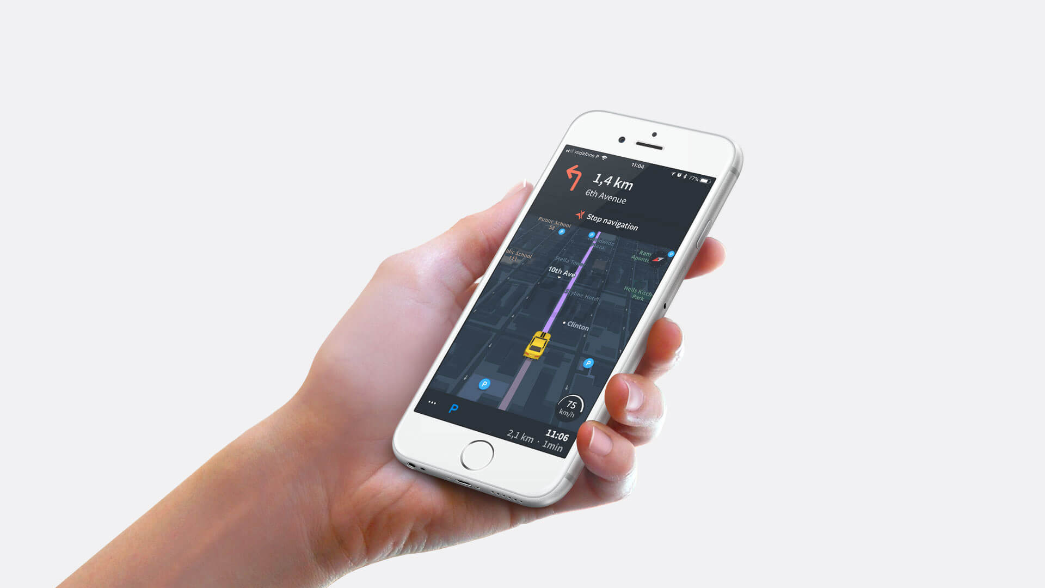
Sat Navs
… To now

Slide 9
Conclusion
Overall there are many advantages and disadvantages of tech changing our lives. I think that we are in a zone where we have just about edged the balance to a little too much technology.
Therefore, I feel that if we continue like this it will ruin the world. I think we need to have a balance in our lives so that the world develops in a healthy all-rounded way.
Also, a current major issue in the world is global warming and if we carry on like this with so much tech usage for example transport then global warming will increase! This would be terrible, so we NEED TO DECREASE THE TIME SPENT ON DEVICES NOW!

